Slide 1
Harmonic Analysis of SHMS HB
Eric Sun
Steve Lassiter
Mike Fowler
March 31, 2015

Slide 2
Hall Probe and Error Plot
Sensor model: LakeShore XHGT-9060
Sensor Type: InAs Hall Generator
Serial number: 55937

Slide 3
Hysteresis Curve
Max relative difference (at -100 A) = 0.84%
Relative difference (at -3800 A) = 0.018%

Slide 4
Upward Difference of Hysteresis Curve
Max upward difference (at 100 A) = 0.34%
Upward difference (3900 A) = 0.014%

Slide 5
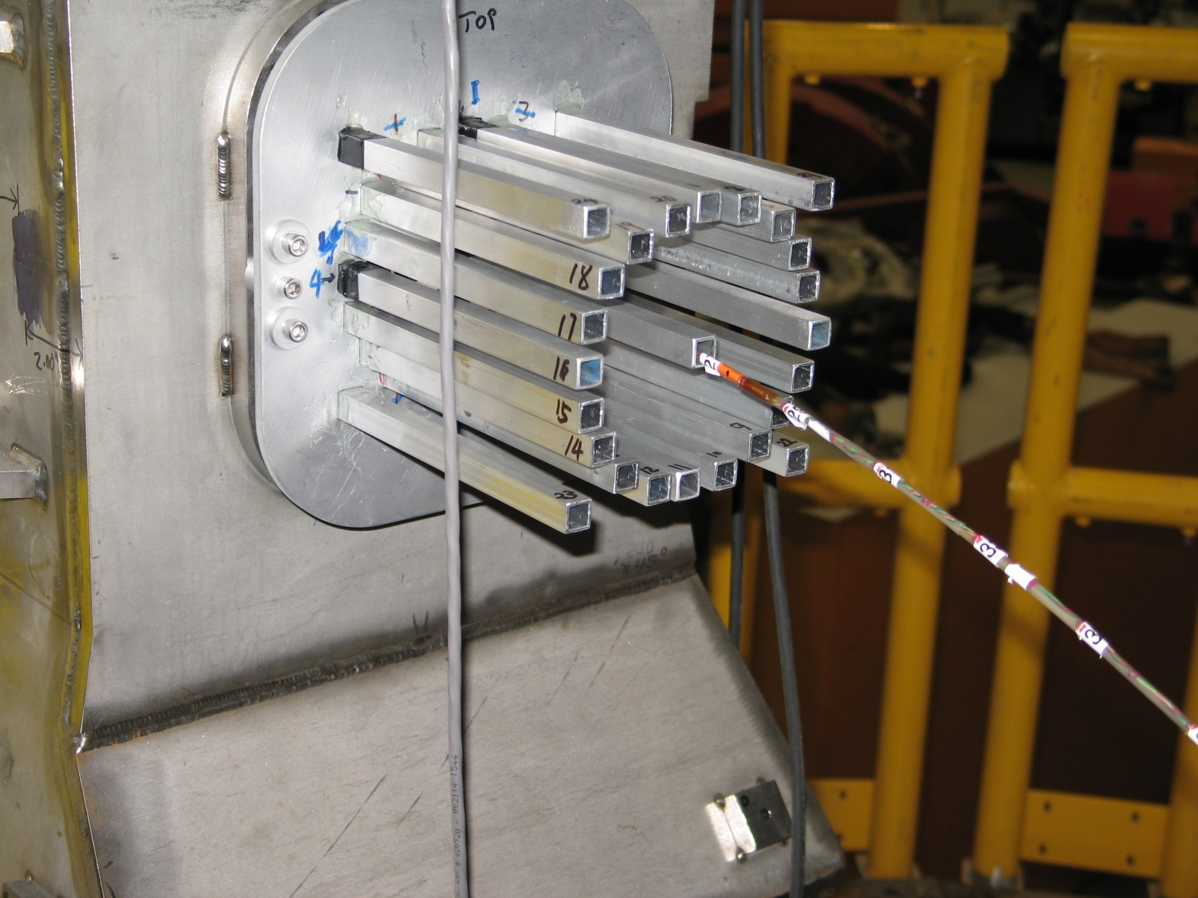
Mapping Fixture
0°
90°
Twenty points were measured on a 5.908 cm circle.

Slide 6
1200 A (negative) at Location 27 (measured on 3/11/2016)
max difference = 0.61% average difference = 0.09% median difference = 0.13%

Slide 7
2000 A (negative) at Location 27 (measured on 3/11/2016)
Abnormal value is due to welds on inner tube of helium vessel.
max difference = 0.68% average difference = 0.19% median difference = 0.22%

Slide 8
3000 A (negative) at Location (measured on 3/11/2016)
max difference = 0.72% average difference = 0.29% median difference = 0.33%

Slide 9
3900 A (negative) at Location 27 (measured on 3/11/2016)
max difference = 0.70% average difference = 0.36% median difference = 0.40%

Slide 10
3900 A (Positive) at Location 27 (measured on 3/11/2016)
max difference = 0.70% average difference = 0.34% median difference = 0.39%

Slide 11
3900 A (Positive) at Location 26 (measured on 3/11/2016)
max difference = 0.75% average difference = 0.37% median difference = 0.44%

Slide 12
3900 A (Positive) at Location 28 (measured on 3/11/2016)
Abnormal value is due to welds on inner tube of helium vessel.
max difference = 0.68% average difference = 0.31% median difference = 0.35%

Slide 13
Harmonics (3900 A, Positive, Location 27)
Measured (21 data points)
Order | Sine | Cosine | Amplitude | Phase | Difference (%)
n | A_n | B_n |  |  | 100*(A_i_T - A_i_M)/B_0_M
0 | 0.00 | -25365.71 | 25365.71 | 180.00
1 | 360.18 | -47.99 | 363.37 | -97.59 | 0.15
2 | 16.26 | 341.01 | 341.40 | -2.73 | -0.50
3 | 32.89 | 3.46 | 33.07 | -84.00 | 0.00
4 | -4.54 | 60.68 | 60.85 | 4.28 | -0.22
5 | -19.29 | -1.12 | 19.32 | 93.31 | -0.11
6 | 9.66 | -15.83 | 18.55 | -148.61 | 0.06
7 | 1.54 | 4.22 | 4.50 | -20.07 | -0.01
8 | 9.44 | 12.25 | 15.47 | -37.62 | 0.05
9 | -7.15 | -2.19 | 7.48 | 107.02 | -0.03
Tosca (21 data points)
Order | Sine | Cosine | Amplitude | Phase | Difference (%)
n | A_n | B_n |  |  | 100*(B_i_T - B_i_M)/B_0_M
0 | 0.00 | -25471.04 | 25471.04 | 180.00 | 0.41
1 | 321.84 | -93.31 | 335.09 | -106.17 | 0.18
2 | 142.95 | 364.74 | 391.76 | -21.40 | -0.09
3 | 32.02 | 16.41 | 35.98 | -62.87 | -0.05
4 | 50.21 | 49.51 | 70.51 | -45.40 | 0.04
5 | 8.62 | 23.66 | 25.18 | -20.03 | -0.10
6 | -4.51 | 2.78 | 5.30 | 58.40 | -0.07
7 | 5.33 | 3.48 | 6.36 | -56.87 | 0.00
8 | -3.53 | 8.72 | 9.41 | 22.06 | 0.01
9 | 1.25 | 4.19 | 4.37 | -16.65 | -0.03
Tosca values were obtained using the same coordinates as the measured ones. The same Fourier Fit was employed for both cases.

Slide 14
3900 A (Positive) at Location 12 (measured on 3/23/2016)
Max/min difference = -5.8% average difference = -1.9% median difference = -1.7%

Slide 15
3900 A (Positive) at Location 15 (measured on 3/23/2016)
Max/min difference = -3.7% average difference = -1.0% median difference = -0.88%

Slide 16
3900 A (Positive) at Location 21 (measured on 3/23/2016)
Max/min difference = -1.0% average difference = -0.28% median difference = -2.6%

Slide 17
3900 A (Positive) at Location 27 (measured on 3/23/2016)
Max/min difference = 0.71% average difference = 0.34% median difference = 0.36%

Slide 18
3900 A (Positive) at Location 33 (measured on 3/23/2016)
Max/min difference = 1.1% average difference = 0.58% median difference = 0.62%

Slide 19
3900 A (Positive) at Location 39 (measured on 3/23/2016)
Max/min difference = 1.6% average difference = 0.39% median difference = 0.53%

Slide 20
3900 A (Positive) at Location 42 (measured on 3/23/2016)
Max/min difference = -3.1% average difference = -1.3% median difference = -1.3%

Slide 21
Summary
Max upward difference (Positive – Negative) of hysteresis curve is less than 0.34% (at 100 A); upward difference is only 0.018% at 3900 A.
Max difference of By field on a 5.908 cm circle is 0.72% at Location 27 (z = 15.5 mm), and 5.8% at Location 12 (z = 396.5 mm).
A_n and B_n of Fourier Fit of 20 measured points and 20 Tosca-calculated points are very close with all measured currents at Location 26, 27, and 28. B_n difference is less than 0.41% for all currents at Location 27.

